Slide 1
MODULE II

Slide 2
Basic Processing Unit
  Bus Organizations – Single and Multiple
  Execution of a complete instruction
  Register transfers, Arithmetic & Logic operations, Memory operations
  Sequencing of control signals
Arithmetic algorithms

Slide 3
Instruction Execution
Two phases for instruction execution -fetch phase and execute phase.
Fetch the contents of memory location pointed by PC and load to IR.
IR<-- [[PC]]
Increment PC, ie, PC<-- [PC]+4
Carry out the actions as per instruction.

Slide 4
PROCESSOR ORGANIZATION
SINGLE BUS
The simplest organization.
The ALU and all registers are interconnected via a single common bus.
The bus is internal to the processor.

Slide 5
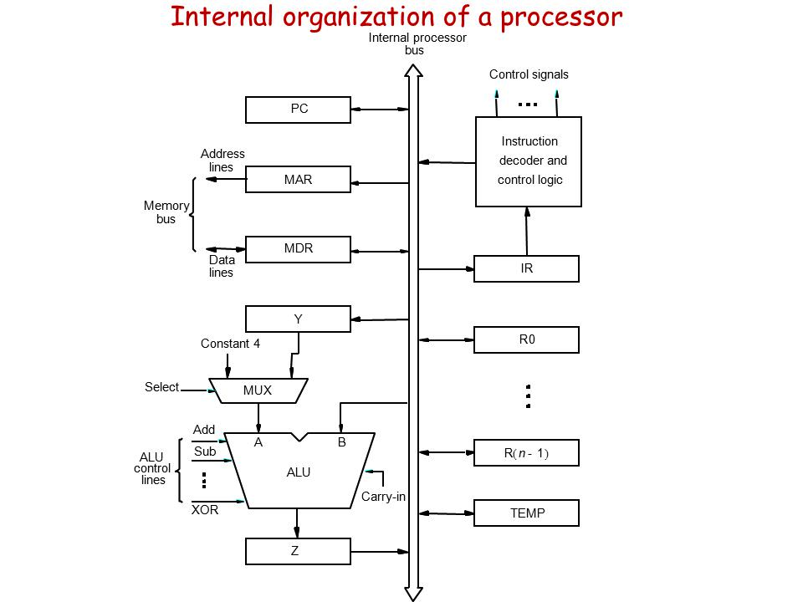

Slide 6
The data and address registers of external memory are connected to processor bus through the MDR and MAR, respectively.
MDR has two inputs and two outputs.
Data may be loaded to MDR either from memory or from internal processor bus.
Input of MAR is connected to processor bus and output to memory.

Slide 7
The Instruction decoder and control logic unit issues signals that control the operation of all units within the processor.
It also interacts with memory bus by issuing the required read or write signals.
The registers R0 through R(n-1) are general purpose registers.

Slide 8
Three registers Y, Z and TEMP are used for temporary storage during ALU operations.
They are never referenced explicitly by any instruction.
The ALU has 2 inputs – one coming from the processor bus and another the output of a multiplexer.

Slide 9
The MUX selects either the content of register Y or a constant 4 as the input A of ALU.
The two select lines are referred to as Select4 and SelectY
The constant 4 is used for incrementing the contents of PC, ie; to do [PC]+4.
The output of ALU is temporarily held in Z.

Slide 10
As instruction execution progresses, data are transferred from one register to another, often passing through ALU.
The instruction decoder and control logic unit carries out the actions specified by the instruction in IR register by issuing proper control signals.
The registers, ALU and bus are collectively called the data path

Slide 11
Most of the instructions can be executed by performing one or more of the following operations is some sequence:
Fetch the contents of a given memroy location and load to a processor register.
Store a word of data from a processor register into a given memory location.

Slide 12
3.Transfer a word from one processor register to another or to the ALU.
4.Perform an arithmetic or logic operation and store result in a register.

Slide 13
REGISTER TRANSFERS
If a register wants to transfer data to another register, it can be done via the bus only.
For each register, two control signals are used.
These either load the contents of register to processor bus or load data on the bus to the register.

Slide 14
The input and output of register Ri is connected to bus via switches and are controlled using signals Ri_in and Ri_out.
Ri_in=1 --> Data on bus loaded to Ri.
Ri_out=1 --> Data in Ri placed in to bus.

Slide 15
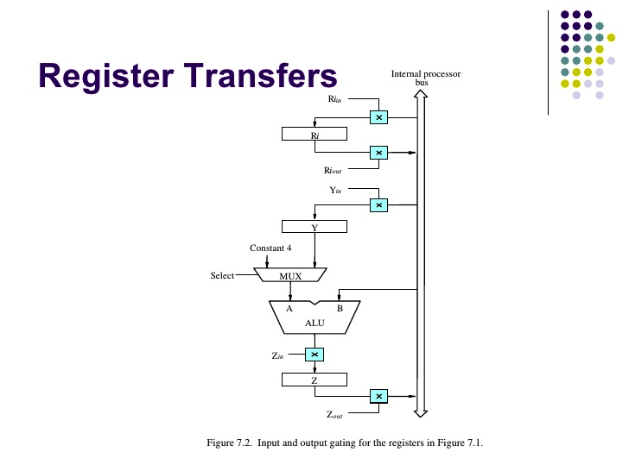

Slide 16
Suppose we want to transfer contents of register R1 to R4. This can be done by following steps.
Enable R1_out. This places contents of R1 to bus.
Enable R4_in. This loads contents of bus to R4.

Slide 17
ALU operations
ALU is a combinational circuit with no internal storage.
It performs operations on the two operands applied at inputs A and B.
One of the operands is the output of a MUX and the other is applied directly.
Result is temporarily stored in Z.

Slide 18
To perform the operation R3 = R1 + R2, the required signals are:
R1_out, Y_in
R2_out, Select Y, Add, Z_in
Z_out, R3_in

Slide 19
In step1, the contents of R1 are placed in bus. Since Y_in is enabled, the contents of bus are loaded to Y. Thus Y now contains the first operand.
In step2, contents of R2 are placed in bus.
Select Y is the selection signal for MUX, so that input A is the contents of Y.

Slide 20
The contents of bus are available at input B of ALU.
When the Add signal is given, ALU performs addition of the operands at the two inputs.
Z_in is enabled, thereby placing result from ALU to Z.

Slide 21
In step 3, contents of Z are placed into the bus.
R3_in is enabled, thereby loading contents of bus to register R3.

Slide 22
MEMORY READ
To fetch a word from memory, the processor has to first specify the address of the memory location where this information is stored and then request a read operation.
The processor transfers the required address to MAR.
At the same time the processor uses the control lines of memory bus to indicate a Read operation is needed.

Slide 23
Once the read operation is done, the requested data received from memory is stored in MDR.
From MDR it is transferred to other registers in the processor.
Input of MAR is connected to processor bus and output to the address lines of memory bus.

Slide 24
MDR register has has two way connections to both processor and memory bus.
Correspondingly it has 4 control signals:
MDR_in and MDR_out control the connection to processor bus.
MDR_inE and MDR_outE control connection to the external bus.

Slide 25
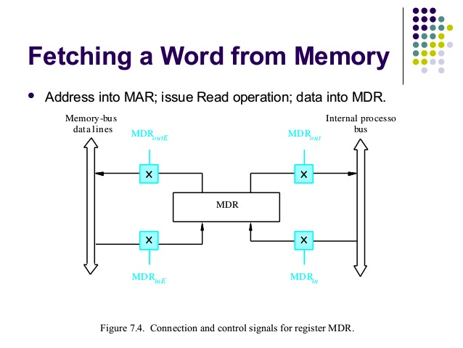

Slide 26
The processor completes one internal data transfer in one clock cycle.
The speed of operation of memory is slower than that of processor.
To accommodate this variability in response time, the processor waits until it receives an indication that the requested memory operation has been completed.
A control signal called MFC (Memory Function Completed) is used to give this indication to the processor.

Slide 27
Consider the operation: Move (R1),R2
We need to get the data in the address specified in R1 and place it in register R2.
First the address in R1 is loaded to MAR.
A read operation is started and processor waits for MFC response.
MDR is loaded with the fetched data.
Data is transferred to R2.

Slide 28
Control Signals are:
R1_out, MAR_in, Read
MDR_in_E, WMFC
MDR_out, R2_in
It is assumed that the MAR_out is always enabled.
WMFC – Wait for MFC

Slide 29
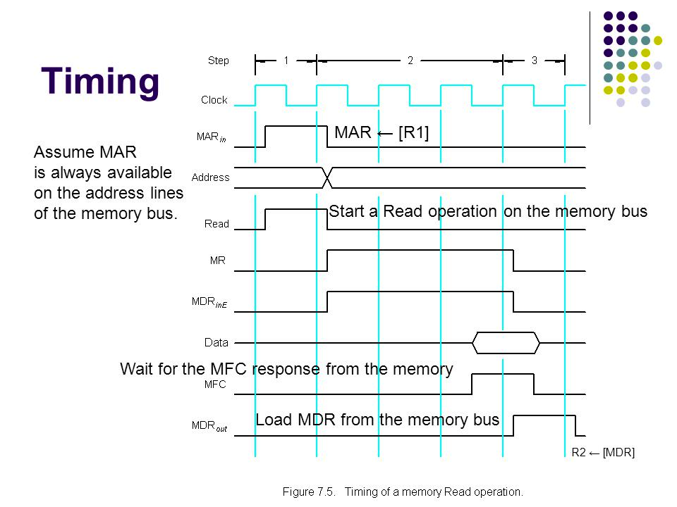

Slide 30
MEMORY WRITE
The desired address is first loaded to MAR.
Then the data to be written is loaded to MDR and a write command is issued.
Wait for the MFC signal.

Slide 31
Move R2, (R1)
R1_out, MAR_in
R2_out, MDR_in, Write
MDR_out_E, WMFC

Slide 32
EXECUTION OF A COMPLETE INSTRUCTION
Consider the instruction
Add (R3),R1
To execute the instruction, following steps are required:
Fetch the instruction
Fetch first operand from memory
Perform addition
Load result into R1

Slide 33
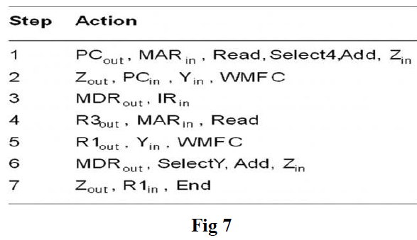

Slide 34
In step 1, instruction fetch is initiated by loading contents of PC to MAR and sending a read request to memory.
Select signal of MUX is set to Select4, so that the constant 4 is selected as input A of ALU.
This value is added to the contents of PC which contains the current data in bus and result is stored in Z.

Slide 35
In step 2, the updated value is moved from Z to PC.
The new value is also copied to Y for calculation of target address in case of branch instructions.
In step 3 , the instruction fetched from memory is transferred from MDR to IR.

Slide 36
The instruction decoding circuit interprets the contents of IR during the beginning of step 4 and appropriate control signals are activated.
Contents of R3 is transferred to MAR and a read control signal is generated.
While waiting for read operation to complete, the contents of R1 are moved to Y.

Slide 37
Once the read is completed, the data is placed from MDR to the processor bus.
The select Y signal is applied to select Y as input A of ALU and add signal is given.
Result goes to Z, from where it is loaded to R1.
End signal causes a new instruction cycle to start.

Slide 38
Branch Instructions
A branch instruction replaces contents of PC with branch target address.
This address is obtained by adding an offset X , given in the branch instruction, to the updated value of PC.
The offset value is extracted from IR by the instruction decoding circuit.

Slide 39
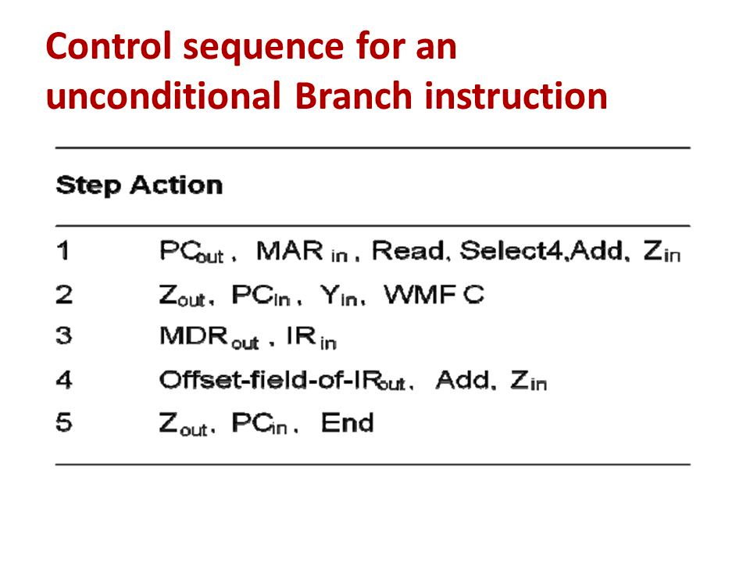

Slide 40
Since the updated value of PC is available in register Y, the offset value is placed in the bus and an add operation is performed.
This new address is then loaded to PC.
After this a new instruction cycle begins.

Slide 41
In case of a conditional branch, we need to check the status of condition codes before loading the new value to PC.
If the condition is not true, the calculated value is not loaded to PC and the execution of next sequential instruction starts.

Slide 42
MULTIPLE BUS ORGANISATION
In a single bus, the control sequences are quite long since only one data transfer can take place over the bus in a clock cycle.
To reduce the number of steps, most commercial processors use multiple bus, which provides multiple internal paths for parallel data transfers.

Slide 43
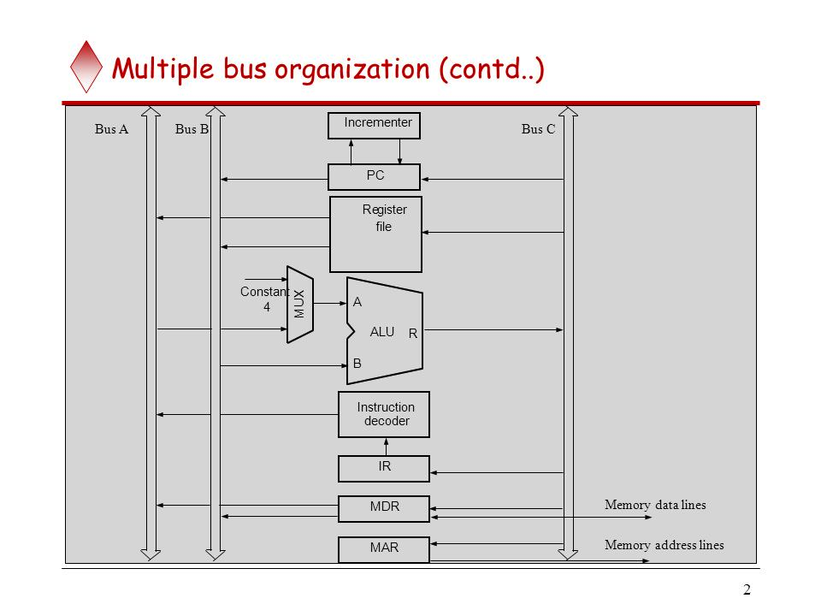

Slide 44
The figure shows a three bus structure.
All general purpose registers are combined into a single block called a register file.
Buses A and B are used to transfer source operands to ALU and bus C transfers result to destination.
An incrementer unit is used to increment the PC
The constant 4 input to the ALU is still used to increment other addresses.

Slide 45
Consider the instruction
Add R4,R5,R6
PC_out, R=B, MAR_in,Read,IncPC
WMFC
MDR_out_B,R=B,IR_in
R4_outA,R5_outB,SelectA,Add,R6_in,End

Slide 46
In step1,the contents of PC are placed in the B bus and passed as such to C bus through the ALU,using R=B.
This is loaded into MAR and a read operation is initiated. IncPC increments contents of PC.
Step 2 waits for the read operation to complete.

Slide 47
Once the instruction is read from memory, it is moved to IR through ALU using the R=B instruction.
In step 4, the contents of register R4 and R5 are placed in buses A and B.
The ALU adds the operands and result is loaded to R6

Slide 48
ARITHMETIC ALGORITHMS
Multiplication of binary numbers in sign magnitude representation.
Done by successive shift and add operations.
The signs of both operands are same, product is positive, else negative.

Slide 49
Hardware Implementation
Two binary numbers are added at a time using a parallel adder and the partial products are accumulated in a register.
The partial products are shifted to right after each step.
When the multiplier bit is zero, no operation is done.

Slide 50
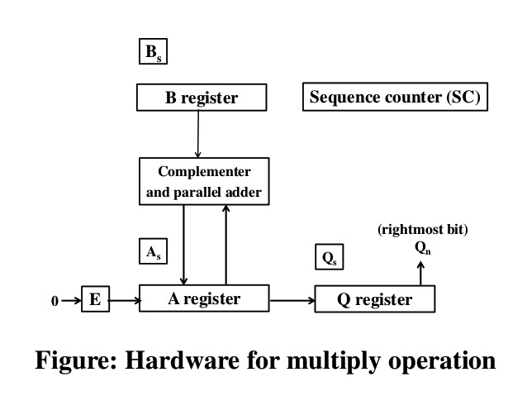

Slide 51
The multiplier is stored in Q register and its sign in Qs.
The multiplicand is in B register and its sign in Bs.
The sequence counter SC is initially set to a value equal to the number of bits in the multiplier and is decremented by 1 after forming each partial product.
When the content of the counter reaches zero the process stops.

Slide 52
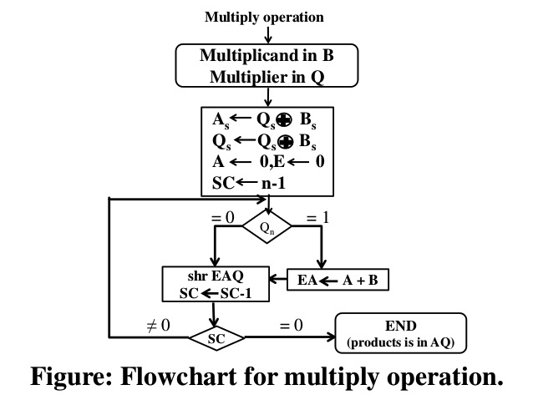

Slide 53
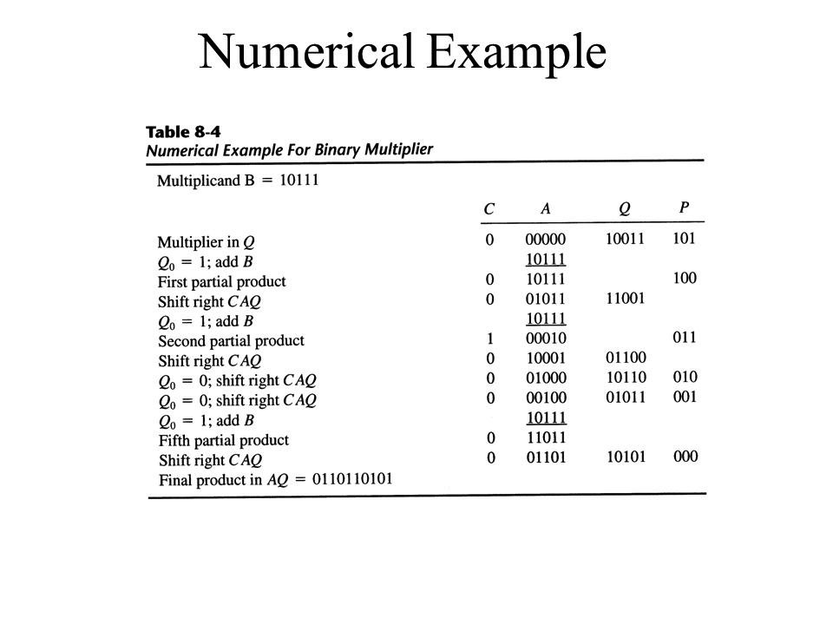

Slide 54
BOOTH MULTIPLICATION ALGORITHM
Multiplies two binary numbers in signed 2's complement representation.
Proposed by Andrew Donald Booth.
Two bits of the multiplier, Qn and Q_{n+1} are examined.
If both are equal (00 or 11), just a shifting of partial product is done. For 01,multiplicand is added to partial product.For 10 multiplicand is subtracted from partial product

Slide 55
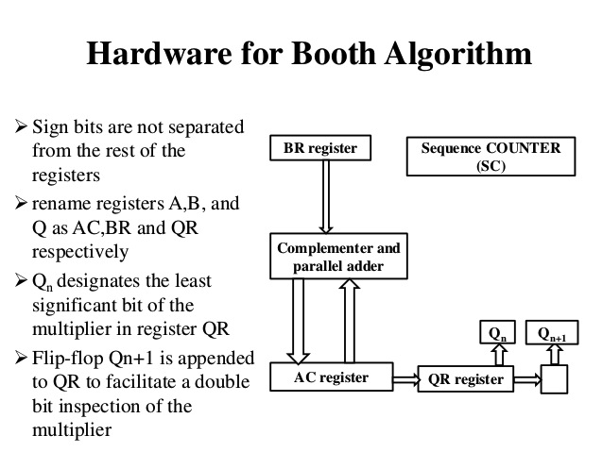

Slide 56
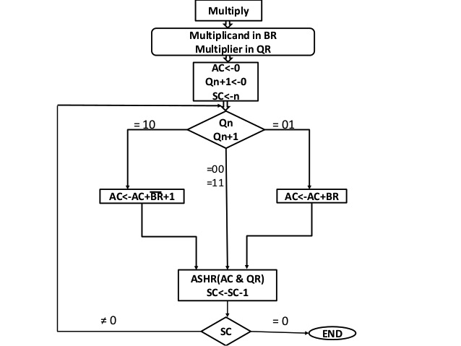

Slide 57
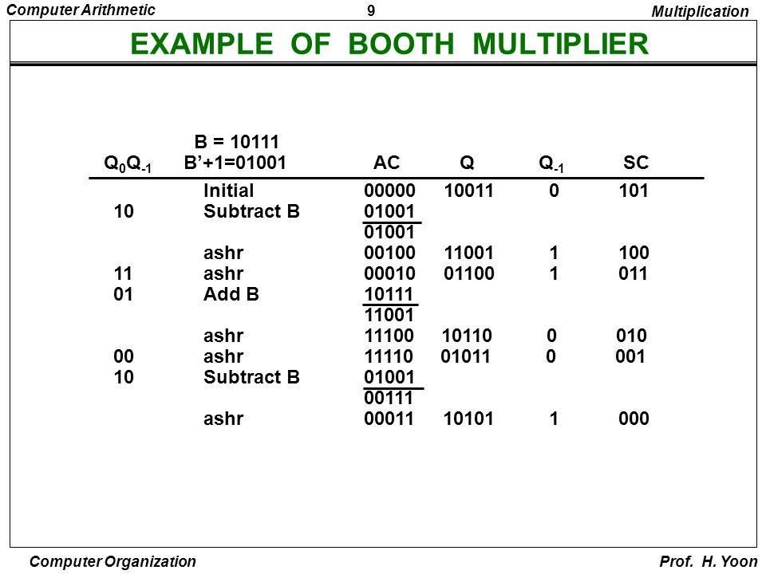

Slide 58
ARRAY MULTIPLIER
Checking the bits of the multiplier one bit at a time and forming partial products is a sequential operation that requires time.
The multiplication of two binary numbers can be done with one micro operation using a special combinational circuit.
Such a circuit that forms the product bits all at once is called an array multiplier.

Slide 59
An array multiplier is fast, but it requires a large number of gates.
For k multiplicand bits and j multiplier bits, we need jxk AND gates and (j-1) k bit adders to produce a product of j + k bits.
Consider the multiplication of two 2bit numbers.

Slide 60
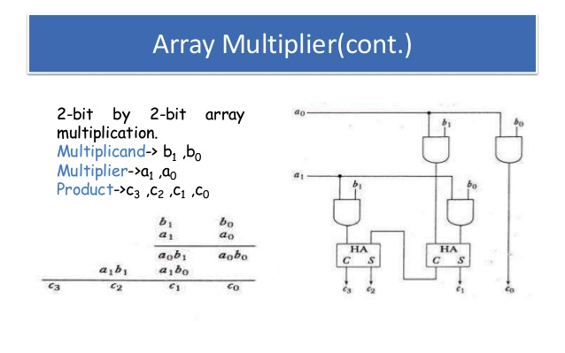

Slide 61
Now consider a 4 bit by 3 bit multiplication.
Since k=4 and j=3, we need 4x3 = 12 AND gates and two 4 bit adders to produce a product of 7 bits.

Slide 62
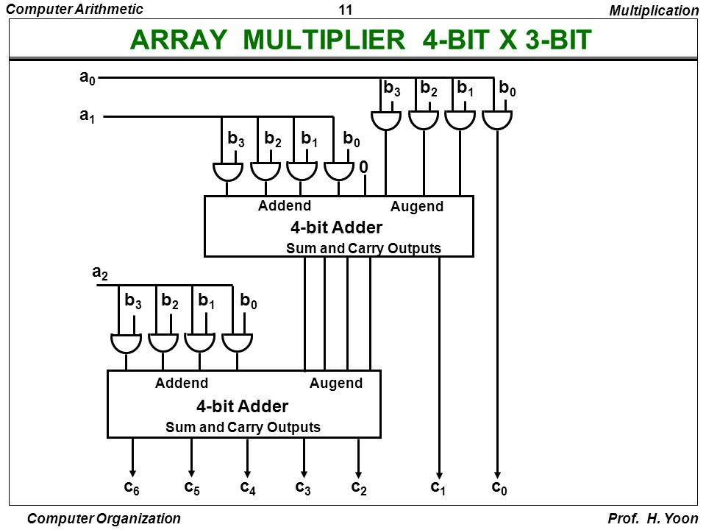

Slide 63
DIVISION ALGORITHMS (For Binary numbers)
Implemented by a series of compare, shift and subtract operations.
If the divisor has n bits and dividend has m bits,
Compare n MSB bits of dividend with divisor. If it is smaller than divisor, take n+1 bits and repeat.
When the compared dividend bits is greater than divisor, place a 1 as quotient bit, shift the divisor once to right and subtract from dividend.
This difference is the partial remainder.

Slide 64
Continue the process by comparing the partial remainder with the divisor.
If partial remainder is greater than divisor, place a 1 as quotient bit and subtract divisor after shifting.
If partial remainder is less than divisor, just shift divisor to right, set quotient bit to 0 and continue.

Slide 65
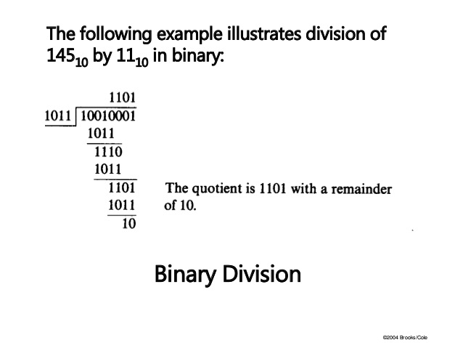

Slide 66
Hardware for division of sign magnitude numbers is similar to that of multiplication.
Divisor is stored in B register and dividend in A and Q.
After division, quotient will be in Q and remainder in A.
The difference here is that the register EAQ is shifted to left with 0 inserted into Qn and previous value of E lost.

Slide 67
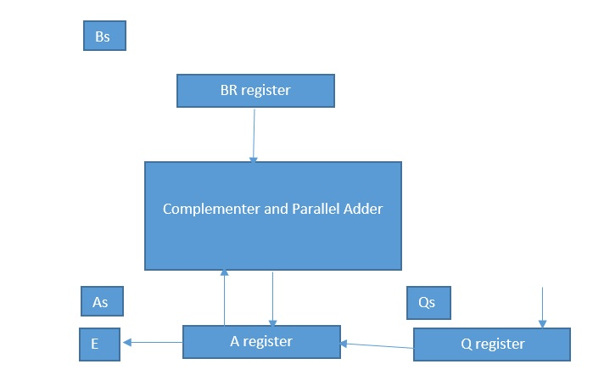

Slide 68
Divisor is in B and dividend in A and Q.
After division, the quotient will be in Q and remainder in A.
Sequence counter is initialized to the number of bits in magnitude of divisor.
Sign of quotient is positive if both operands have same sign, else negative.
Remainder has the same sign as that of dividend.

Slide 69
If a division operation produces a quotient that is too large to fit into the destination register, divide overflow exception results.
This causes a CPU interrupt, and the current program halts.

Slide 70
The division overflow can occur if the value of the half most significant bits of the dividend is equal to or greater than the value of the divisor.
Similarly, the overflow can occur if the dividend is divided by a 0.
The overflow flip-flop DVF is set to 1 if the overflow occurs.

Slide 71
For example consider the operation,
1111000000 / 10001
Assuming, we are using 5 bit registers, Divisor is stored in B and dividend in A and Q
Higher order half bits of dividend = 11110, which is greater than the divisor 10001.
After division the quotient will be 111000, which can not be contained in the available register size.

Slide 72
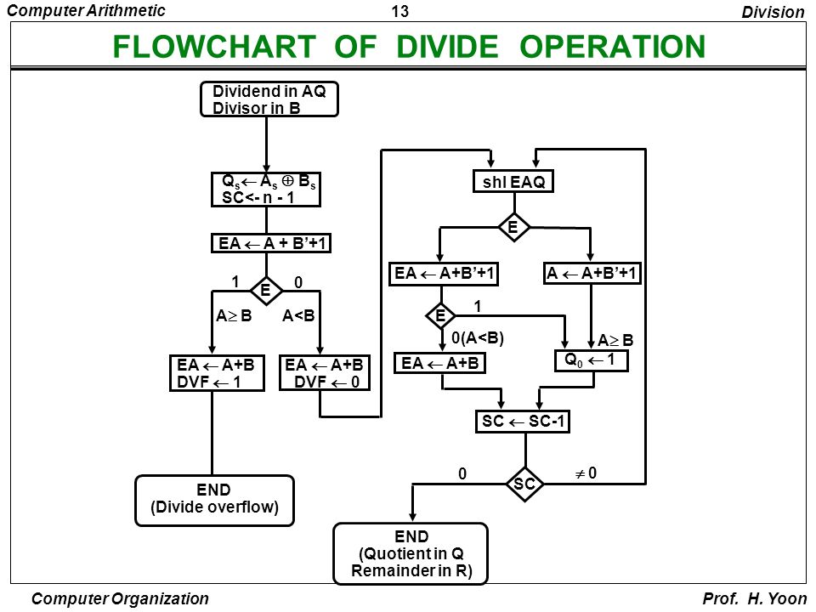

Slide 73
Dividend is in A and Q and divisor in B.
SC is initialized and sign of quotient determined.
Next steps are intended to detect divide overflow.
For this, the divisor in B is subtracted from the higher order half bits of dividend (in A) and the carry flip-flop (E) is inspected.

Slide 74
If E=1,it means that A>=B, which indicates the possibility of divide overflow.
Then the DVF flip-flop is set to 1 and division operation is stopped.
If E=0, it means A<B and divide overflow will not occur.
In this case, the previous value in A is restored by the operation EA = A+B and DVF is set to 0.

Slide 75
Next, the contents of E, A and Q registers are shifted to the left.
After this step, we need to set the quotient bit depending on whether now A is greater than or less than B.
After shifting, if E=1, it means that the contents of A (a 1 followed by n bits) are greater than B (n bits). Hence the quotient bit Qn is set to 1.

Slide 76
If E=0, in this stage we can’t be sure if A is less than or greater than B. Hence we subtract B from A and check the value of E.
Now, if E=1, it means A>B, so we can set Qn=1
If E=0, A<B. Qn remains 0 and we want to restore the previous value of A. So EA = A+B is performed.

Slide 77
Now once cycle of operation is completed.
Hence SC is decremented by 1 and if SC!=0, the operation continues.
Finally the quotient will be in Q and remainder in R.

Slide 78
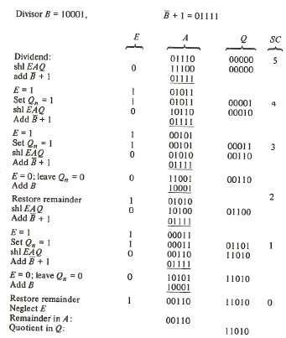

Slide 79
The discussed method is called restoring method of division.
In each step, the partial remainder is restored by adding the divisor to the negative difference.
Two other methods for binary division are:
  Comparison Method
  Non restoring Method.

Slide 80
In comparison method, A and B are compared prior to subtraction. Only if A >=B, B is subtracted from A.
In non restoring method, the restoring of partial products is not done.
If Qn=1,we do A-B and if Qn=0, we do A+B.
Flowchart is as given.

Slide 81
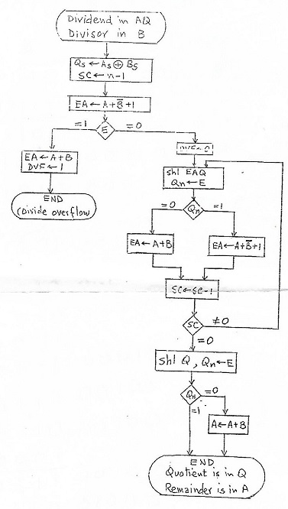

Slide 82
Floating Point Arithmetic Operations
A floating point number consists of two parts – a mantissa m and an exponent e.
Represented as m*r^{e}
A floating point number is normalized if the most significant digit of mantissa is nonzero.
A floating point number is usually represented with a biased exponent. Bias is a positive number added to each exponent so that internally all exponents are positive.

Slide 83
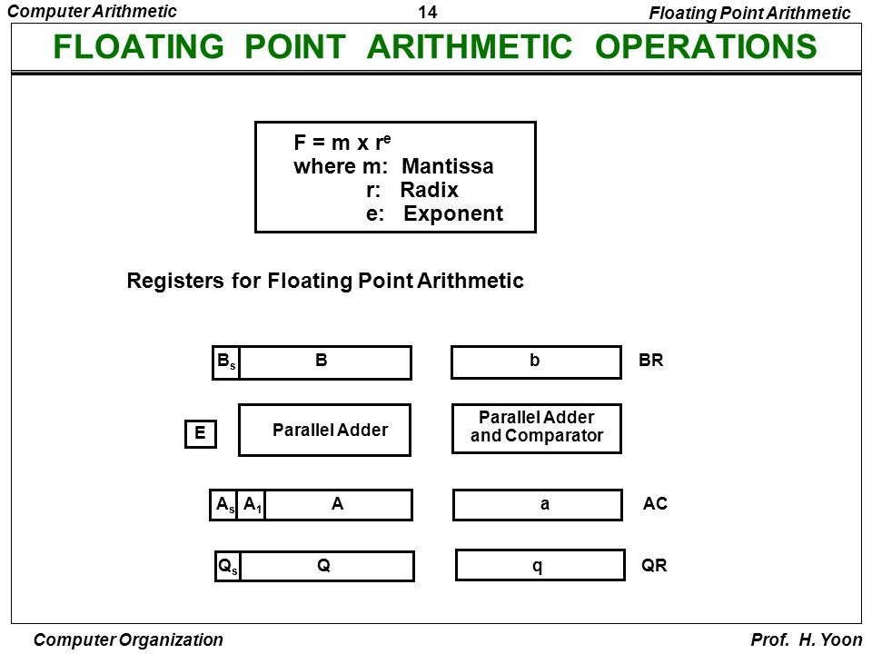

Slide 84
Three registers BR, AC and QR. Each is subdivided into two parts. - sign, mantissa and exponent.
Each number has a mantissa in sign-mag representation and a biased exponent.
The MSB bit of each number must be nonzero for the number to be normalized.

Slide 85
A parallel adder adds the mantissas and transfers the sum into A and carry to E.
A separate parallel adder is used for exponents.
Also a comparator is provided to compare the exponents.

Slide 86
MULTIPLICATION
We multiply the mantissas and add the exponents.
No comparison and alignment of exponents is necessary.
Multiplication of mantissas is done in the same way as that of binary numbers in sign-mag representation.

Slide 87
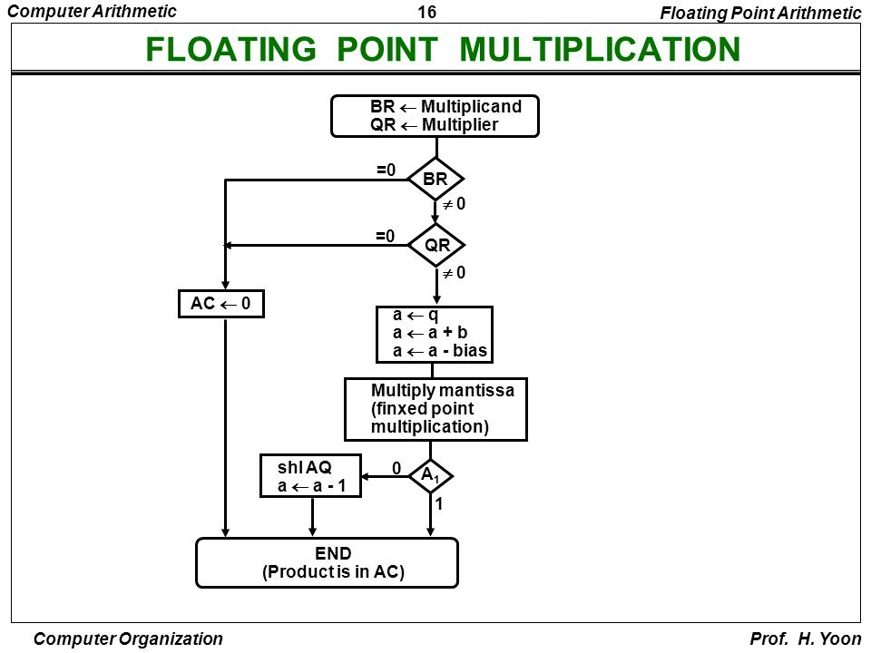

Slide 88
Four steps
  Check for zeros
  Add the exponents
  Multiply mantissas
  Normalize the product

Slide 89
The multiplicand is in BR and multiplier in QR.
First both operands are checked to see if either one is a zero, if so the product in AC is set to 0.
Otherwise the exponents are added.
The exponent of multiplier,q, is transferred to a and added to the exponent of multiplicand,b.

Slide 90
Since both exponents are biased, the sum will have double the bias. So subtract the bias number from the sum to get the correct value.
Now the mantissas are multiplied in the same way as fixed point numbers.
The MSB of A is checked to see if there is an underflow.
If A1=0, it is shifted left and exponent decremented until we have a 1 in the MSB posiition.

Slide 91
DIVISION
Here the exponents are subtracted and mantissas divided.
Division is done in the same way as that for fixed point numbers in sign -mag representation.
If the dividend is greater than or equal to divisor, the dividend fraction is shifted to right and its exponent incremented by 1.
This process is called dividend alignment and this ensures that divide overflow doesn't occur.

Slide 92
Divisor is stored in BR and dividend in AC.
Quotient is in QR.
Five steps:
  Check for zeros.
  Initialize registers and evaluate sign
  Align dividend
  Subtract exponents
  Divide the mantissas

Slide 93
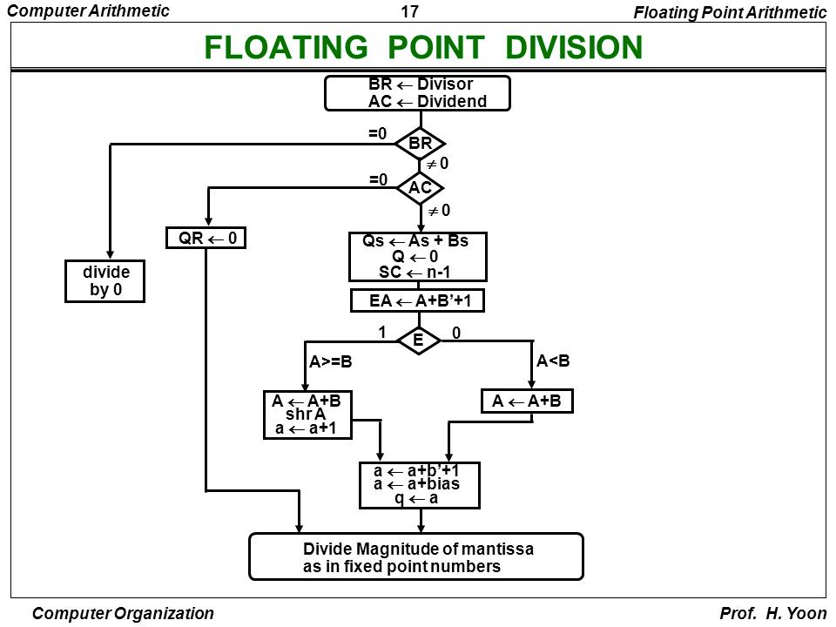

Slide 94
If dividend = 0, QR is set to 0
If divisor =0, a divide by zero error is generated and operation stops.
If operands are nonzero, the sign of quotients is determined and stores in Qs
To perform dividend alignment, the two mantissas are compared by subtraction.
Carry E determines the relative magnitude.

Slide 95
The dividend is restored by adding the divisor.
If E=1, A>=B and we need to shift A once to the right and increment the dividend exponent.
Next the divisor exponent is subtracted from dividend exponent.
The subtraction cancels out the biases, so a bias value is added to the result and transferred to q.
Mantissas are divided as in the fixed point case.

